Slide 1
Design Of FIR Filter Design
Module :5 Week 9

Slide 2
Design of FIR Filters
FIR filters are employed in filtering problems where there is a requirement for a linear phase characteristics within the pass band of the filter.
Ideal filters are non-causal and hence physically unrealizable for real-time signal processing applications.
Causality implies that the frequency response characteristics H(ω) of the filter cannot be zero , except at a finite set of points in the frequency range.

Slide 3
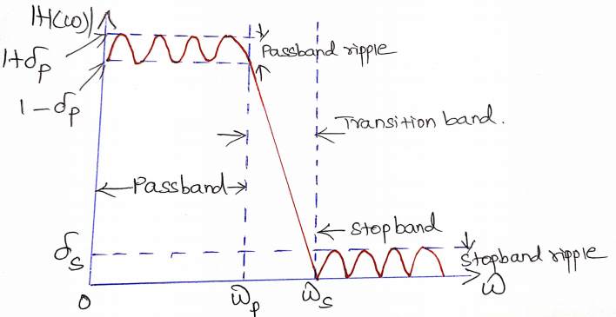
H(ω) cannot have an infinitely sharp cut-off from pass band to stop band , i.e. H(ω) cannot drop from unity to zero abruptly.
It is not necessary to insist that the magnitude |H(ω)| be constant in the entire pass band of the filter.
A small amount of ripple in the pass band and stop band is usually tolerable.

Slide 4
Definitions of Basic Terms
Filtering: process of extraction of desired signal from noise
Filter: system performing filtering
Analog filtering: filtering performed on continuous-time signals and yields continuous-time signals
Digital/discrete-time filtering: filtering performed on digital/discrete-time signals and yields digital/ discrete-time signals

Slide 5
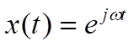
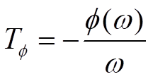
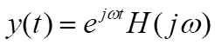
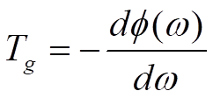
Phase response
The phase response is the relationship between the phase of a sinusoidal input and the output signal passing through the system, such as an amplifier or a filter.
Phase delay: a measure of the time delay of the phase
Group delay: First derivative of phase delay
Input:
Output:

Slide 6
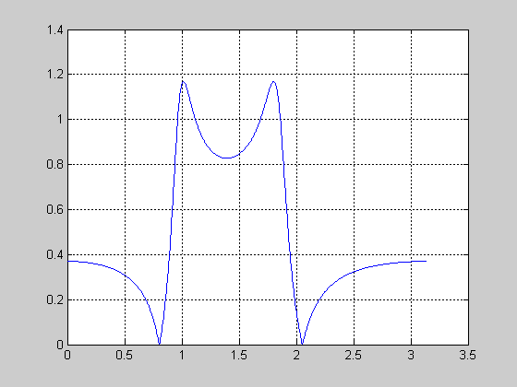
pass-band ripple
stop-band ripple
(attenuation)
6

Slide 7
Design of FIR filters
Following methods are available to design FIR filters
Linear Phase FIR filter design
Windowing Techniques
Frequency sampling method
Fourier series method

Slide 8
Linear phase(LP) FIR filters
Symmetric impulse response h(n)
h(n) = h(N-1-n) , 0≤n ≤(N-1)
Anti symmetric impulse response h(n)
h(n) = -h(N-1-n) , 0≤n ≤(N-1)
Case I : symmetric h(n), N = odd
Case II : symmetric h(n), N = even
Case III : Anti-symmetric h(n), N = odd
Case IV : Anti-symmetric h(n), N = even

Slide 9
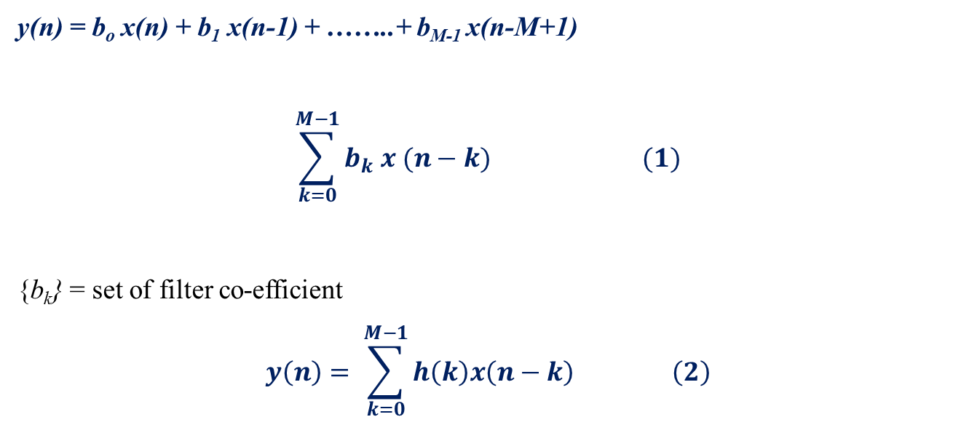
Design of Linear phase FIR Filter
An FIR filter of length M with input x(n) and output y(n) is described by the difference equation
y(n) = b_{o} x(n) + b₁ x(n-1) + ……..+ b_{M-1} x(n-M+1)
$$\sum_{k=0}^{M−1}{b_{k} x (n−k)} (1)$$
{b_{k}} = set of filter co-efficient
$$y\left(n\right)= \sum_{k=0}^{M−1}{h\left(k\right)x\left(n−k\right) \left(2\right)}$$

Slide 11
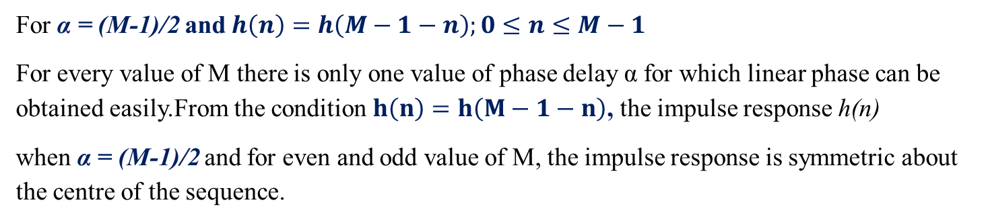
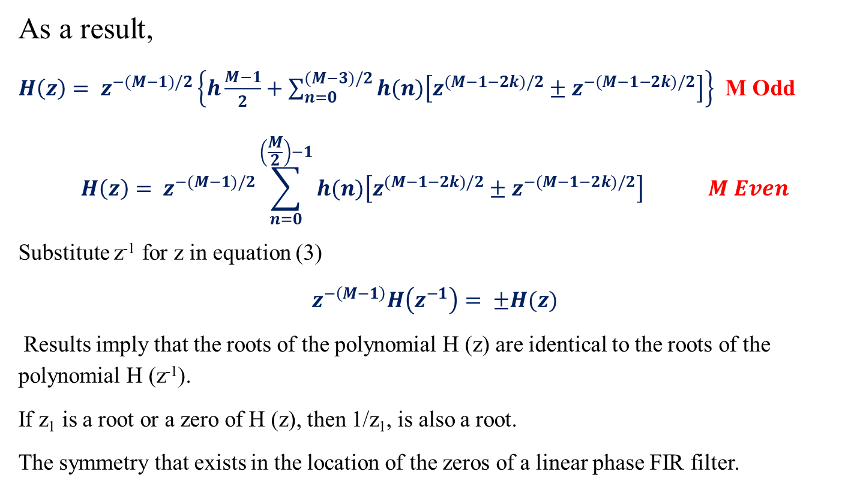
As a result,
$H\left(z\right)= z^{−(M−1)/2}\left\{h\frac{M−1}{2}+\sum_{n=0}^{(M−3)/2}{h(n)\left[z^{(M−1−2k)/2}±z^{−(M−1−2k)/2}\right]}\right\}$ M Odd
$$H\left(z\right)= z^{−(M−1)/2}\sum_{n=0}^{\left(\frac{M}{2}\right)−1}{h(n)\left[z^{(M−1−2k)/2}±z^{−(M−1−2k)/2}\right] } M Even$$
Substitute z⁻¹ for z in equation (3)
$$z^{−\left(M−1\right)}H\left(z^{−1}\right)= ±H(z)$$
Results imply that the roots of the polynomial H (z) are identical to the roots of the polynomial H (z⁻¹).
If z₁ is a root or a zero of H (z), then 1/z₁, is also a root.
The symmetry that exists in the location of the zeros of a linear phase FIR filter.
For α = (M-1)/2 and $h\left(n\right)=h\left(M−1−n\right);0≤n≤M−1$
For every value of M there is only one value of phase delay α for which linear phase can be obtained easily.From the condition $h\left(n\right)=h\left(M−1−n\right)$, the impulse response h(n)
when α = (M-1)/2 and for even and odd value of M, the impulse response is symmetric about the centre of the sequence.

Slide 12
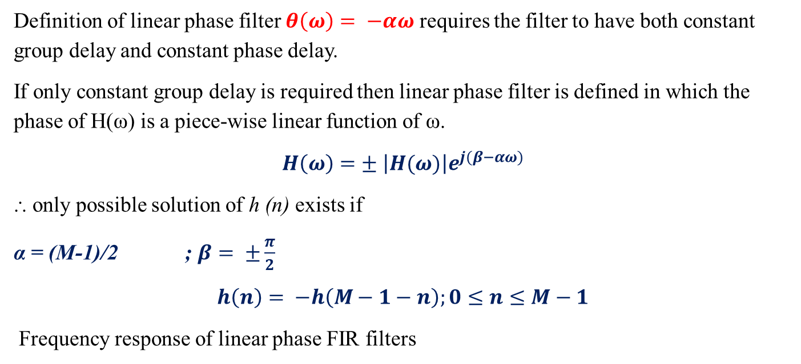
Definition of linear phase filter $θ\left(ω\right)= −αω$ requires the filter to have both constant group delay and constant phase delay.
If only constant group delay is required then linear phase filter is defined in which the phase of H(ω) is a piece-wise linear function of ω.
$$H\left(ω\right)=± \left|H(ω)\right|e^{j(β−αω)}$$
⸫ only possible solution of h (n) exists if
α = (M-1)/2 ; $β= ±\frac{π}{2}$
$$h\left(n\right)= −h\left(M−1−n\right);0≤n≤M−1$$
Frequency response of linear phase FIR filters
Symmetrical impulse response when M=odd and M=Even
Anti-Symmetrical impulse response M= odd and M= Even

Slide 13
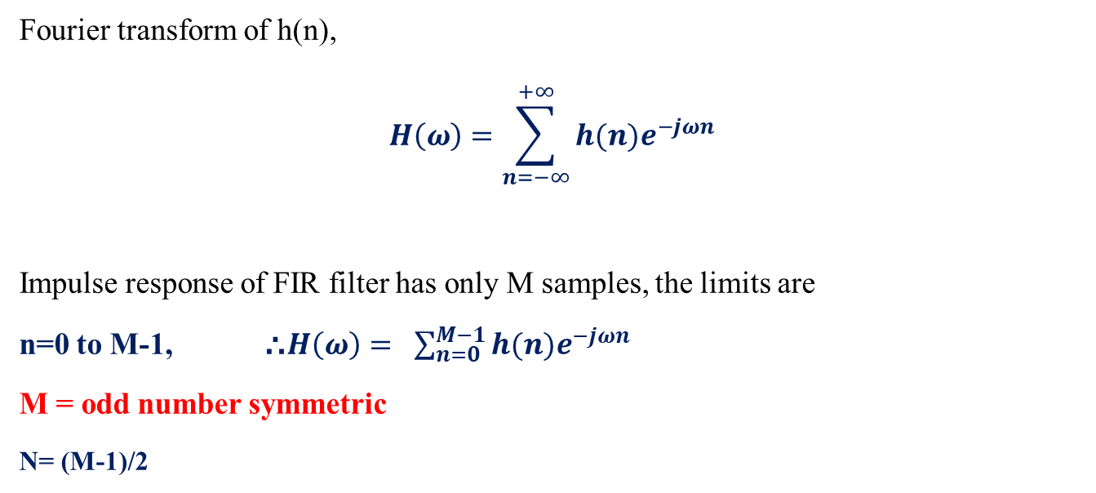
Case 1: Frequency response of linear phase FIR filter when impulse response is symmetrical and N is odd
Fourier transform of h(n),
$$H\left(ω\right)=\sum_{n=−∞}^{+∞}{h(n)e^{−jωn}}$$
Impulse response of FIR filter has only M samples, the limits are
n=0 to M-1, ⸫$H\left(ω\right)= \sum_{n=0}^{M−1}{h(n)e^{−jωn}}$
M = odd number symmetric
N= (M-1)/2

Slide 14
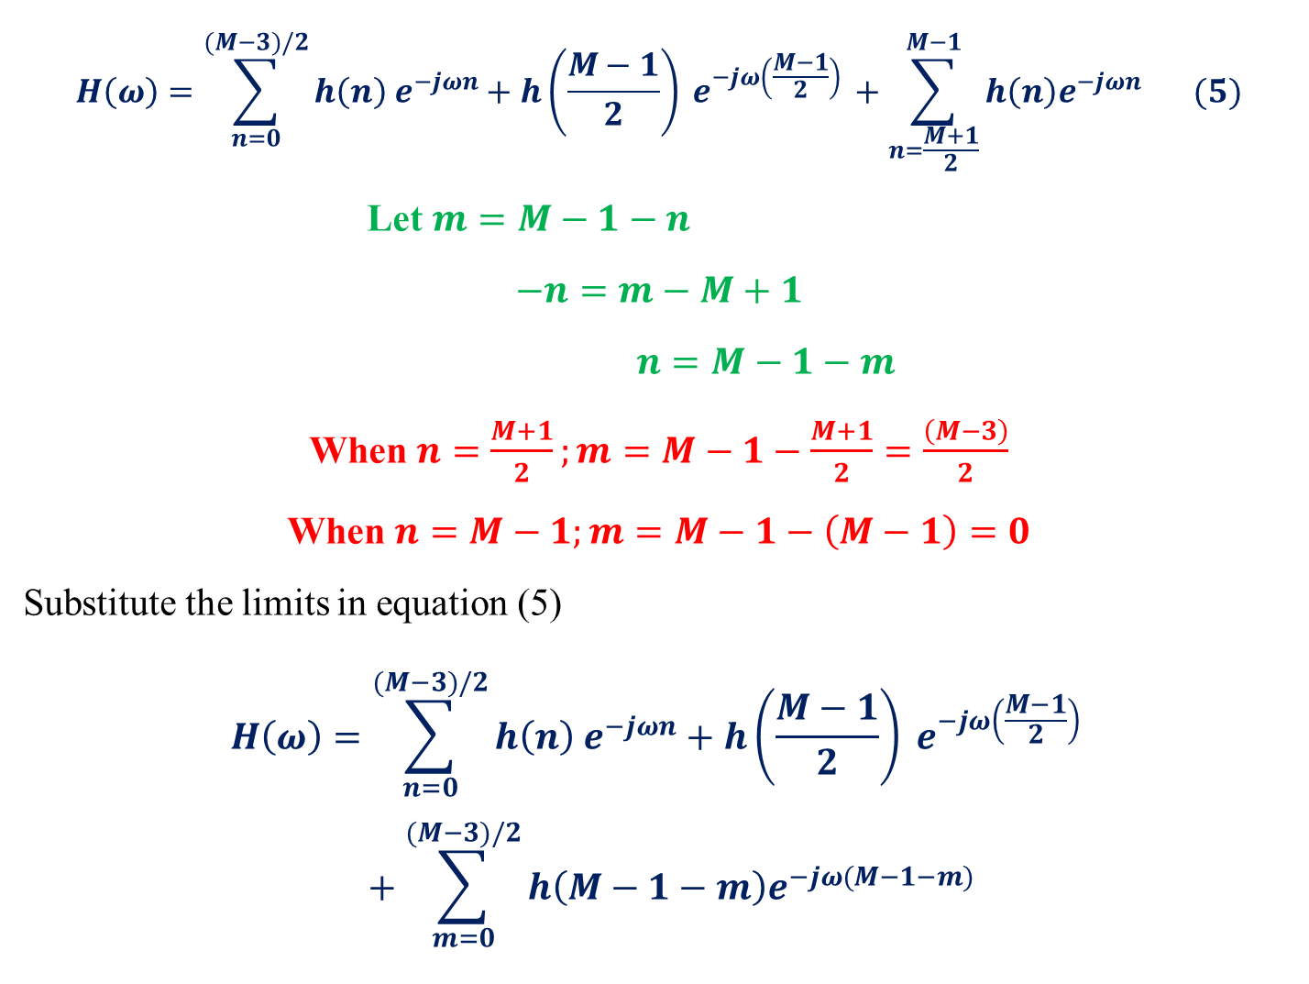
$$H\left(ω\right)=\sum_{n=0}^{(M−3)/2}{h\left(n\right) e^{−jωn}+h\left(\frac{M−1}{2}\right)} e^{−jω\left(\frac{M−1}{2}\right) }+\sum_{n=\frac{M+1}{2}}^{M−1}{h\left(n\right)e^{−jωn}} (5)$$
Let $m=M−1−n$
$$−n=m−M+1$$
$n=M−1−m$
When $n=\frac{M+1}{2};m=M−1−\frac{M+1}{2}=\frac{\left(M−3\right)}{2}$
When $n=M−1;m=M−1−\left(M−1\right)=0$
Substitute the limits in equation (5)
$$H\left(ω\right)=\sum_{n=0}^{(M−3)/2}{h\left(n\right) e^{−jωn}+h\left(\frac{M−1}{2}\right)} e^{−jω\left(\frac{M−1}{2}\right) }+\sum_{m=0}^{(M−3)/2}{h\left(M−1−m\right)e^{−jω(M−1−m)}}$$

Slide 15
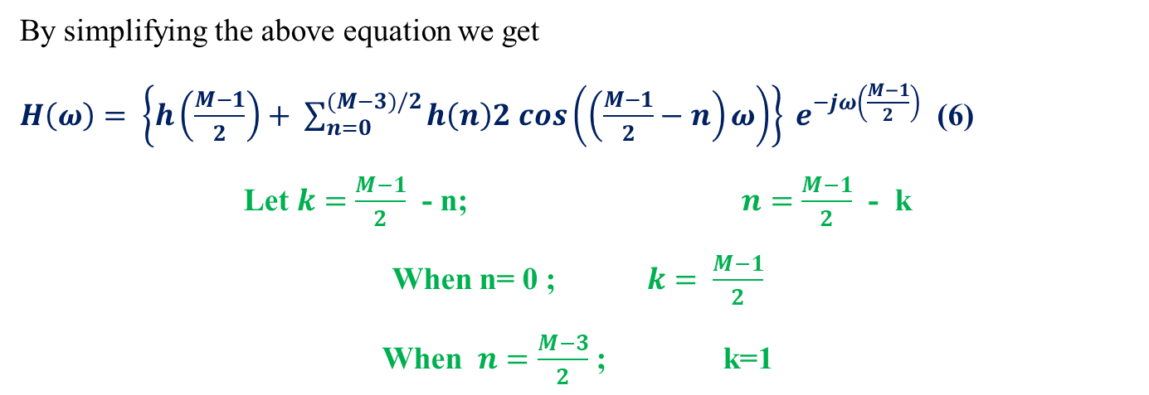
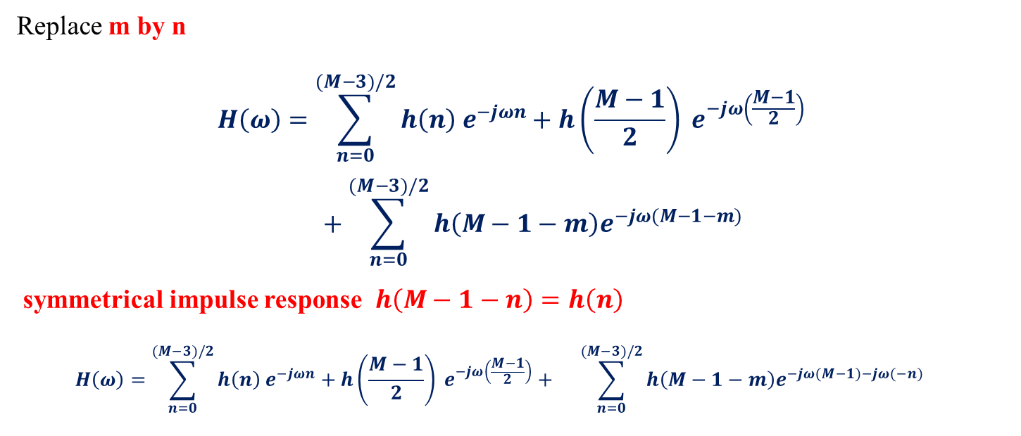
Replace m by n
$$H\left(ω\right)=\sum_{n=0}^{(M−3)/2}{h\left(n\right) e^{−jωn}+h\left(\frac{M−1}{2}\right)} e^{−jω\left(\frac{M−1}{2}\right) }+\sum_{n=0}^{(M−3)/2}{h\left(M−1−m\right)e^{−jω(M−1−m)}}$$
symmetrical impulse response $h\left(M−1−n\right)=h\left(n\right)$
$$H\left(ω\right)=\sum_{n=0}^{(M−3)/2}{h\left(n\right) e^{−jωn}+h\left(\frac{M−1}{2}\right)} e^{−jω\left(\frac{M−1}{2}\right)}+ \sum_{n=0}^{(M−3)/2}{h\left(M−1−m\right)e^{−jω(M−1)−jω(−n)}}$$
By simplifying the above equation we get
$H\left(ω\right)= \left\{h\left(\frac{M−1}{2}\right)+ \sum_{n=0}^{(M−3)/2}{h\left(n\right)2 cos\left(\left(\frac{M−1}{2}−n\right)ω\right)}\right\} e^{−jω\left(\frac{M−1}{2}\right)}$ (6)
Let $k=\frac{M−1}{2}$ - n; $n=\frac{M−1}{2}$ - k
When n= 0 ; $k= \frac{M−1}{2}$
When $n=\frac{M−3}{2}$ ; k=1

Slide 16
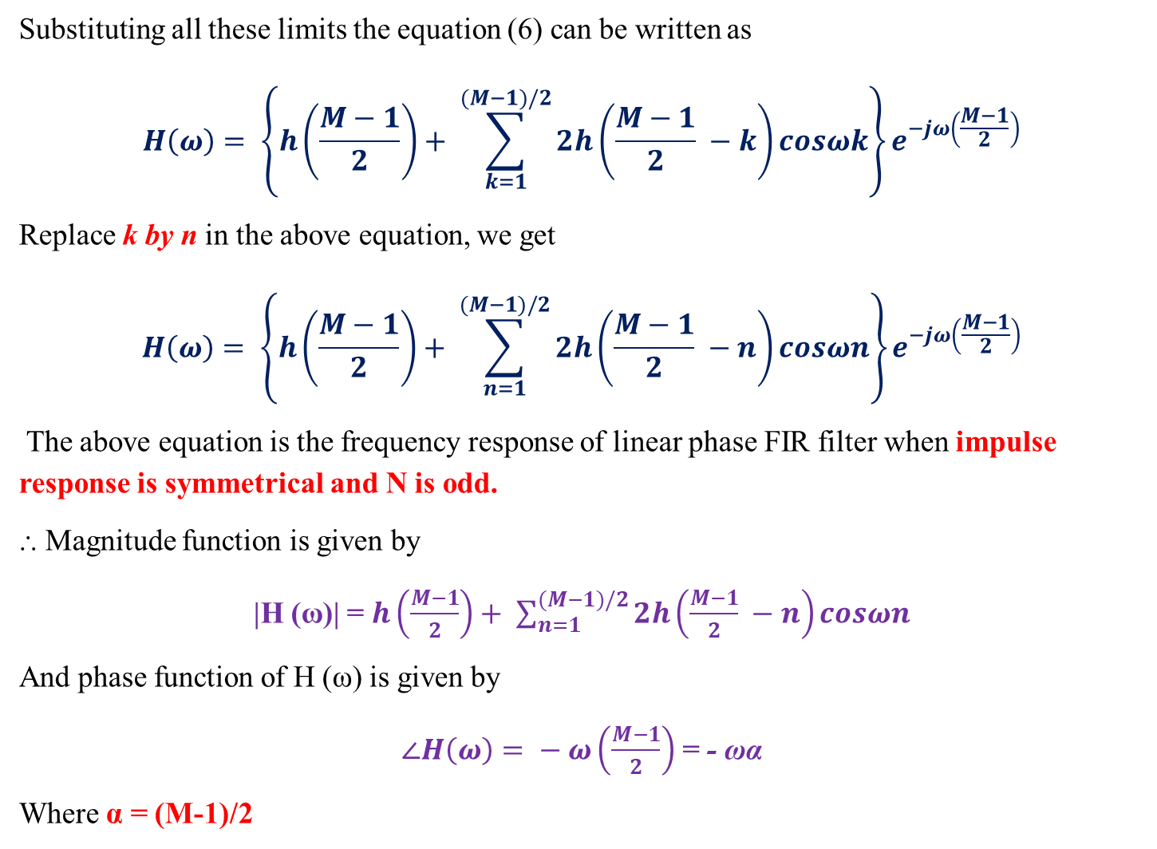
Substituting all these limits the equation (6) can be written as
$$H\left(ω\right)= \left\{h\left(\frac{M−1}{2}\right)+ \sum_{k=1}^{(M−1)/2}{2h\left(\frac{M−1}{2} −k\right)cosωk}\right\}e^{−jω\left(\frac{M−1}{2}\right)}$$
Replace k by n in the above equation, we get
$$H\left(ω\right)= \left\{h\left(\frac{M−1}{2}\right)+ \sum_{n=1}^{(M−1)/2}{2h\left(\frac{M−1}{2} −n\right)cosωn}\right\}e^{−jω\left(\frac{M−1}{2}\right)}$$
The above equation is the frequency response of linear phase FIR filter when impulse response is symmetrical and N is odd.
⸫ Magnitude function is given by
|H (ω)| =$h\left(\frac{M−1}{2}\right)+ \sum_{n=1}^{(M−1)/2}{2h\left(\frac{M−1}{2} −n\right)cosωn}$
And phase function of H (ω) is given by
$∠H\left(ω\right)= − ω\left(\frac{M−1}{2}\right)$ = - ωα
Where α = (M-1)/2

Slide 17
